Slide 1
Math 152 – Lesson 20/21
Lesson | Topic | Reading
19 | Modeling w/ Diff Eq/Dir Fields | 9.1/9.2
20/21 | Separable Equations | 9.3
22 | Models for Population Growth | 9.4
Objectives:
Determine if a differential equation is separable
Solve separable differential equations & apply initial conditions
Model and solve mixing problems using differential equations

Slide 2
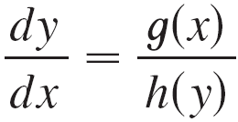
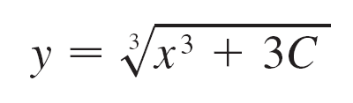
Separable Equations
Separable Eqns works on first-order differential equations like:
This equation can be separated into a function of x and a function of y
Example:
y² dy = x² dx

Slide 3



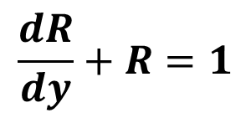

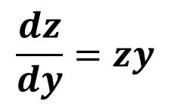
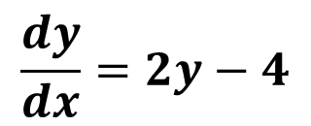



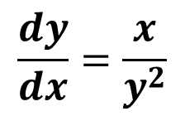

Board Work
$$\frac{dz}{dy}=zy$$
$$1.$$
$$z=3 when y=0$$
$$\frac{dy}{dx}=\frac{x}{y^{2}}$$
$$2.$$
$$y\left(0\right)=2$$
$$\frac{dR}{dy}+R=1$$
$$3.$$
$$R\left(1\right)=0.1$$
$$4.$$
$$\frac{dy}{dx}=2y−4$$
$$Through the Point (1,5)$$

Slide 4

Answers
1.
2. $\frac{dy}{dx}=\frac{x}{y^{2}}$ $y\left(0\right)=2$ $y^{}$ = ${(\left(\frac{3}{2}\right)x^{2}+8)}^{(\frac{1}{3})}$
3.
4. through (1,5)

Slide 5
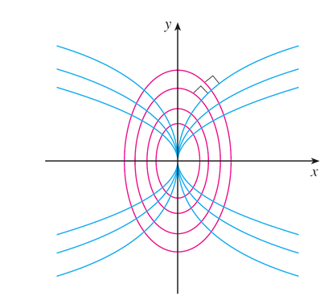
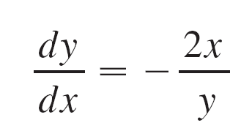
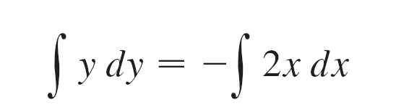
Orthogonal Trajectories
Find the orthogonal trajectories for:
Orthogonal = - slope
run
rise

Slide 6
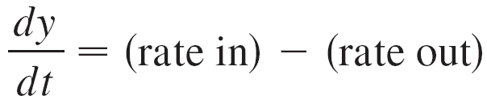
Mixing Problems
If y (t) denotes the amount of substance in the tank at time t, then y ′(t) is the rate at which the substance is being added minus the rate at which it is being removed.

Slide 7
Example 6
A tank contains 20 kg of salt dissolved in 5000 L of water. Brine that contains 0.03 kg of salt per liter of water enters the tank at a rate of 25 L/min. The solution is kept thoroughly mixed and drains from the tank at the same rate. How much salt remains in the tank after half an hour?

Slide 8
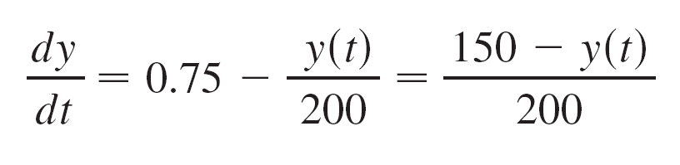
Example 6
Solution:
y (t) = amount of salt (kg) after t minutes.
Given: y (0) = 20 Find: y (30)
Where the concentration at time t is y (t)/5000
Separable Eqn

Slide 9
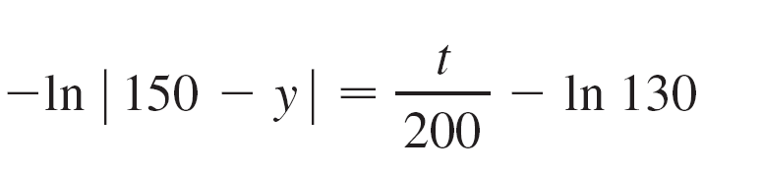
Solution
Plug in initial condition
| 150 – y | = 130e^{–t/200}
Since y (t) is continuous, y (0) = 20, and the right side is never 0, we deduce that 150 – y (t) is always positive.
y (t) = 150 – 130e^{–t/200}
y (30) = 150 – 130e^{–30/200} ≈ 38.1kg

Slide 10
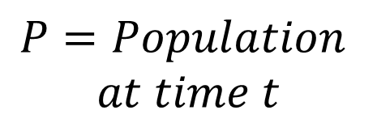

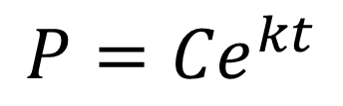
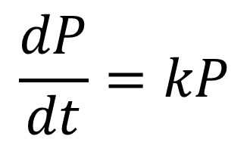
Next: Population Growth
Model: Over time, population grows at a rate proportional to the size of the population.
Variables:
Differential Equation:
$$\frac{dP}{dt}=kP$$
$$t=Time$$
$$P=Population$$
$$at time t$$
General Solution:
$$P={Ce}^{kt}$$

Slide 11
Backups

Slide 12
BW #1

Slide 13
BW #2

Slide 14
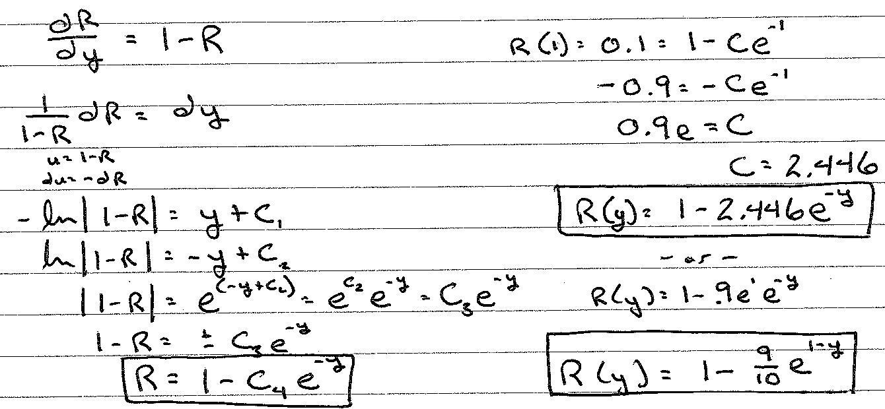
BW #3
Notes:
1-(9e/10)e^(-x) -or- 1-(9/10)e^(1-x)
same-same

Slide 15
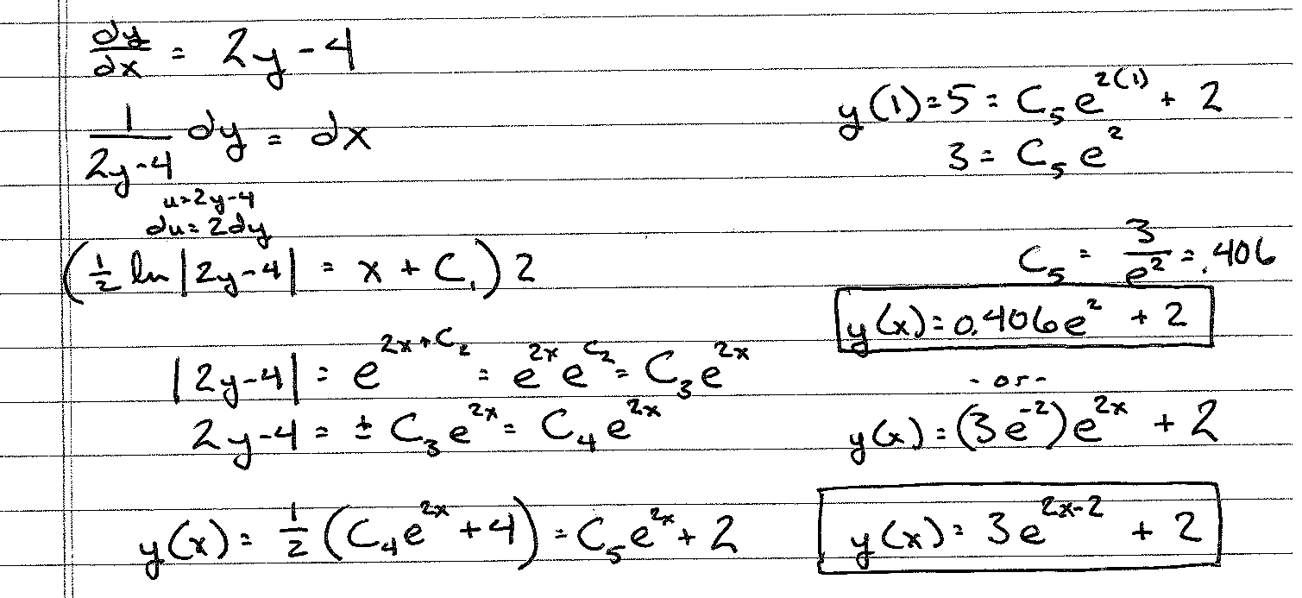
BW #4
x
Notes:
(3/e^2)e^(2x)+2 -or- 3e^(2x-2)+2

Slide 16

Board Work
For what values of k does the function $y=\cos\left(kt\right)$ satisfy the differential equation $4y^{′′}=−25y$? (answer: +/- 5/2)
Notes:
+- 5/2

